Slide 1
Navigating Connecticut’s Waste Crisis
Virtual One-Year Follow Up
February 12, 2025
1:00 PM
Notes:
Welcome & introductions…
Last year we met to discuss the situation that the State of CT Solid Waste system was in, its impact on the SCRRRA member municipalities, and what we have done to mitigate the issues. We would like to bring you up to date with what has occurred in the past year and our continuing efforts to provide disposal services to the SCRRRA towns at the lowest cost possible.

Slide 2
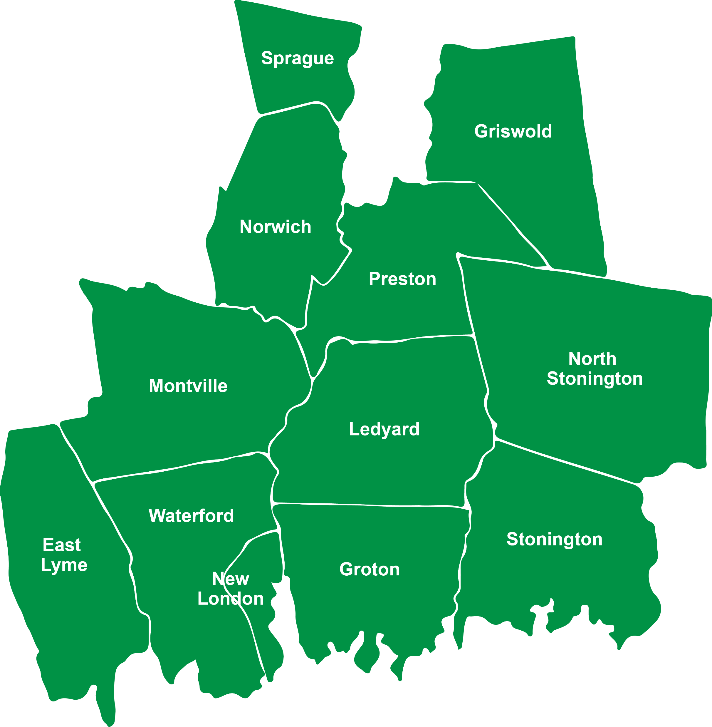
SCRRRA Member Municipalities
Notes:
As most of you know, SCRRRA is a regional solid waste authority that was created in the 1980's for the construction of the waste to energy facility in Preston. Over the years SCRRRA, through its management and Board, has broadened its responsibility to include, in addition to waste disposal, municipal recycling, transfer station programs and financial support including brush grinding, hazardous waste management and recycling outreach and education.

Slide 3
Connecticut Situational Analysis
Notes:
Unfortunately, little has changed since our meeting in December 2023 in that there have been no significant additions to solid waste disposal infrastructure within the state. We are still sending approximately 40% of our solid waste (over 850,000 tons) to out-of-state facilities at great expense to towns and residents both financially and environmentally. Two significant recycling facility upgrades have been completed in that timeframe, retrofits to both the USA Hauling facility in Berlin and the Casella facility in Willimantic promise to significantly increase capacity and improved capture of recycled materials.

Slide 4
Tip Fee vs. Service Fee
Tip Fee =
Disposal Cost
Disposal Cost + SCRRRA Services
Service Fee =
Notes:
When considering the financial picture of solid waste disposal in the state we look at the tip fee paid, which
is the per ton cost for delivering solid waste to a waste processing facility. In SCRRRA's case, we charge
member towns a Service Fee, which includes both the Tip Fee for delivering waste as well as all the
additional services that SCRRRA provides.

Slide 5
SCRRRA Services
SCRRRA Services
SERVICE | ESTIMATED FY 2025 TOWN BENEFIT
MSW Disposal Tip Fee Subsidy | $1,151,500
Notes:
Those services include MSW tip fee, Recycling tip fee, a transportation offset subsidy, brush grinding,
HHW collections, various Transfer Station programs, as well as public education and support.
Tip fees around the state have continued to rise.

Slide 6
SCRRRA Services
SCRRRA Services
SERVICE | ESTIMATED FY 2025 TOWN BENEFIT
MSW Disposal Tip Fee Subsidy | $1,151,500
Recycling Tip Fee Subsidy | 1,150,000
Notes:
Those services include MSW tip fee, Recycling tip fee, a transportation offset subsidy, brush grinding,
HHW collections, various Transfer Station programs, as well as public education and support.
Tip fees around the state have continued to rise.

Slide 7
SCRRRA Services
SCRRRA Services
SERVICE | ESTIMATED FY 2025 TOWN BENEFIT
MSW Disposal Tip Fee Subsidy | $1,151,500
Recycling Tip Fee Subsidy | 1,150,000
Transportation (Hauling) Subsidy | 250,000
Notes:
Those services include MSW tip fee, Recycling tip fee, a transportation offset subsidy, brush grinding,
HHW collections, various Transfer Station programs, as well as public education and support.
Tip fees around the state have continued to rise.

Slide 8
SCRRRA Services
SCRRRA Services
SERVICE | ESTIMATED FY 2025 TOWN BENEFIT
MSW Disposal Tip Fee Subsidy | $1,151,500
Recycling Tip Fee Subsidy | 1,150,000
Transportation (Hauling) Subsidy | 250,000
Wood & Brush Grinding | 239,600
Notes:
Those services include MSW tip fee, Recycling tip fee, a transportation offset subsidy, brush grinding,
HHW collections, various Transfer Station programs, as well as public education and support.
Tip fees around the state have continued to rise.

Slide 9
SCRRRA Services
SCRRRA Services
SERVICE | ESTIMATED FY 2025 TOWN BENEFIT
MSW Disposal Tip Fee Subsidy | $1,151,500
Recycling Tip Fee Subsidy | 1,150,000
Transportation (Hauling) Subsidy | 250,000
Wood & Brush Grinding | 239,600
Household Hazardous Waste Collection & Paper Shred Events | 272,000
Notes:
Those services include MSW tip fee, Recycling tip fee, a transportation offset subsidy, brush grinding,
HHW collections, various Transfer Station programs, as well as public education and support.
Tip fees around the state have continued to rise.

Slide 10
SCRRRA Services
SCRRRA Services
SERVICE | ESTIMATED FY 2025 TOWN BENEFIT
MSW Disposal Tip Fee Subsidy | $1,151,500
Recycling Tip Fee Subsidy | 1,150,000
Transportation (Hauling) Subsidy | 250,000
Wood & Brush Grinding | 239,600
Household Hazardous Waste Collection & Paper Shred Events | 272,000
Transfer Station Programs (Batteries, light bulbs, tires, used oil, antifreeze, freon, gas cylinders, and more…) | 141,500
Notes:
Those services include MSW tip fee, Recycling tip fee, a transportation offset subsidy, brush grinding,
HHW collections, various Transfer Station programs, as well as public education and support.
Tip fees around the state have continued to rise.

Slide 11
SCRRRA Services
SCRRRA Services
SERVICE | ESTIMATED FY 2025 TOWN BENEFIT
MSW Disposal Tip Fee Subsidy | $1,151,500
Recycling Tip Fee Subsidy | 1,150,000
Transportation (Hauling) Subsidy | 250,000
Wood & Brush Grinding | 239,600
Household Hazardous Waste Collection & Paper Shred Events | 272,000
Transfer Station Programs (Batteries, light bulbs, tires, used oil, antifreeze, freon, gas cylinders, and more…) | 141,500
Public Education & Outreach | 33,400
TOTAL | $3,238,000
Notes:
Those services include MSW tip fee, Recycling tip fee, a transportation offset subsidy, brush grinding,
HHW collections, various Transfer Station programs, as well as public education and support.
Tip fees around the state have continued to rise.

Slide 12
MSW Tip Fees
CT Average Tip Fee
Notes:
Last December we showed you a graph that DEEP produced to project tip fee levels to 2026. Those fees are
depicted in red, and we added the SCRRRA service in blue. To add some updated data points the HRRA
tip fee is $106, MIRA is $131, and we are at $75.38.

Slide 13
MSW Tip Fees
CT Average Tip Fee
SCRRRA Service Fee
Notes:
Last December we showed you a graph that DEEP produced to project tip fee levels to 2026. Those fees are
depicted in red, and we added the SCRRRA service in blue. To add some updated data points the HRRA
tip fee is $106, MIRA is $131, and we are at $75.38.

Slide 14
MSW Tip Fees
CT Average Tip Fee
HRRA Towns
SCRRRA Service Fee
Notes:
Last December we showed you a graph that DEEP produced to project tip fee levels to 2026. Those fees are
depicted in red, and we added the SCRRRA service in blue. To add some updated data points the HRRA
tip fee is $106, MIRA is $131, and we are at $75.38.

Slide 15
MSW Tip Fees
CT Average Tip Fee
MIRA Towns
HRRA Towns
SCRRRA Service Fee
Notes:
Last December we showed you a graph that DEEP produced to project tip fee levels to 2026. Those fees are
depicted in red, and we added the SCRRRA service in blue. To add some updated data points the HRRA
tip fee is $106, MIRA is $131, and we are at $75.38.

Slide 16
MSW Tip Fees
CT Average Tip Fee
MIRA Towns
HRRA Towns
SCRRRA Service Fee
Notes:
Last December we showed you a graph that DEEP produced to project tip fee levels to 2026. Those fees are
depicted in red, and we added the SCRRRA service in blue. To add some updated data points the HRRA
tip fee is $106, MIRA is $131, and we are at $75.38.

Slide 17
State of Connecticut Progress Update
SCRRRA Services
Grant Programs:
Strategic Materials Management (SMM)
Regional Waste Authority (RWA)
Materials Management Infrastructure (MMI)
Notes:
DEEP has issued a series of grant programs intended to 1) SMM grants to identify processes to improve waste diversion through pilot programs, 2) RWA grants to organize communities into Regional Authorities like SCRRRA, and 3) MMI grants to provide funding for construction of infrastructure that reduce/divert more waste to recycling and would allow the State to be more self-sufficient. The infrastructure grant opportunity had $15 million in available capital funding. SCRRRA has submitted an application for $4.5M to cover the cost of construction of the food waste composting facility, grant awards are to be announced later this month. DEEP is promising to provide an additional $7 million in Sustainable Materials Management grants this year. Several years ago, DEEP created the Connecticut Coalition for Sustainable Materials Management (CCSMM), a group made up of DEEP, municipal leadership, industry professionals and non-profits to discuss, analyze and propose solutions to manage the waste crisis in the State. That organization continues to be the primary driving force behind the strategies that are being developed for tackling the problem.

Slide 18
State of Connecticut Progress Update
SCRRRA Services
Grant Programs:
Strategic Materials Management (SMM)
Regional Waste Authority (RWA)
Materials Management Infrastructure (MMI)
Connecticut Coalition for Sustainable Materials Management (CCSMM)
Notes:
DEEP has issued a series of grant programs intended to 1) SMM grants to identify processes to improve waste diversion through pilot programs, 2) RWA grants to organize communities into Regional Authorities like SCRRRA, and 3) MMI grants to provide funding for construction of infrastructure that reduce/divert more waste to recycling and would allow the State to be more self-sufficient. The infrastructure grant opportunity had $15 million in available capital funding. SCRRRA has submitted an application for $4.5M to cover the cost of construction of the food waste composting facility, grant awards are to be announced later this month. DEEP is promising to provide an additional $7 million in Sustainable Materials Management grants this year. Several years ago, DEEP created the Connecticut Coalition for Sustainable Materials Management (CCSMM), a group made up of DEEP, municipal leadership, industry professionals and non-profits to discuss, analyze and propose solutions to manage the waste crisis in the State. That organization continues to be the primary driving force behind the strategies that are being developed for tackling the problem.

Slide 19
SCRRRA Situational Analysis

Slide 20
Key SCRRRA Contracts
SCRRRA Services
Municipal Service Agreements - 12 member towns
Solid Waste Disposal – WIN Waste
Municipal Recycling – Willimantic Waste (Casella)
Notes:
MSAs
Municipal Service Agreements are in place with all member municipalities until 12/31/2030.
Waste Disposal
Waste Disposal contract with Win Waste is in place until 12/31/2030 and is subject to inflation capped at 3%. We are currently paying $75.38 per ton, budgeted for $77.64 per ton in FY 2026.
Municipal Recycling
Municipal recycling contract with Willimantic Waste is in place until 12/31/2030 and is also subject to inflation capped at 3%. We are currently paying $65.71 per ton, budgeted $68.08 per ton in FY 2026. This contract has a provision that if we reduce our level of contamination we can reduce our base fee by up to 5%, approximately $100,000 per year!

Slide 21
Service Fee Policy
Adopted November 2023:
Achieve full cost/revenue equilibrium by December 31, 2030.
Maintain service fees in line with the ongoing escalation of costs as determined by the marketplace, planned at a 10.7% increase annually.
Notes:
SCRRRA is adhering to the Board Service Fee Policy that was adopted last year. The Service Fee increase will rise for the FY 2026 budget by 10.7%.

Slide 22
SCRRRA Mitigation Plan
SCRRRA Services
SERVICE | ESTIMATED ANNUAL SAVINGS (FY 2030)
Notes:
SCRRRA has been working toward the design and construction of the only publicly owned, commercial-scale compost facility in CT. The original design of this facility will facilitate the diversion of 7500 tons of source separated food waste from disposal at the waste to energy plant at comparatively low cost. This will equate to an estimated savings of up to $500,000 per year when our lucrative MSW disposal contract expires. To date we have accomplished:
Design - The design is complete subject to minor modifications.
Zoning - Approval is complete, Environmental Justice plan was accepted by DEEP, and the permit is in the final technical phase of approval.
Grants - USDA grant for equipment was awarded worth $400,000, DEEP MMI grant is pending, the request was $4.5 million for construction. We received letters of support from all 12 SCRRRA town CEO's and 6 state representatives, a huge level of support. Thank you.
Operator/Product Marketer - an RFQ was issued and 4 proposals were received, a selection is anticipated to be made by the SCRRRA Board in March.

Slide 23
SCRRRA Mitigation Plan
SCRRRA Services
SERVICE | ESTIMATED ANNUAL SAVINGS (FY 2030)
Food Waste Diversion | $500,000
Notes:
SCRRRA has been working toward the design and construction of the only publicly owned, commercial-scale compost facility in CT. The original design of this facility will facilitate the diversion of 7500 tons of source separated food waste from disposal at the waste to energy plant at comparatively low cost. This will equate to an estimated savings of up to $500,000 per year when our lucrative MSW disposal contract expires. To date we have accomplished:
Design - The design is complete subject to minor modifications.
Zoning - Approval is complete, Environmental Justice plan was accepted by DEEP, and the permit is in the final technical phase of approval.
Grants - USDA grant for equipment was awarded worth $400,000, DEEP MMI grant is pending, the request was $4.5 million for construction. We received letters of support from all 12 SCRRRA town CEO's and 6 state representatives, a huge level of support. Thank you.
Operator/Product Marketer - an RFQ was issued and 4 proposals were received, a selection is anticipated to be made by the SCRRRA Board in March.

Slide 24
SCRRRA Mitigation Plan
SCRRRA Services
SERVICE | ESTIMATED ANNUAL SAVINGS (FY 2030)
Food Waste Diversion | $500,000
Municipal Recycling Cleanup | 100,000
Notes:
SCRRRA has been working to reduce contamination in the curbside recycling stream to improve recyclability and reduce cost. Per our new contract, the recycling company will be conducting individual town audits that track individual municipal performance. We are developing effective AI technology, advertising and community outreach to support our municipalities in their efforts to reduce the level of contamination. These efforts could lead to annual savings of more than $100,000 when our waste contracts expire.

Slide 25
SCRRRA Mitigation Plan
SCRRRA Services
SERVICE | ESTIMATED ANNUAL SAVINGS (FY 2030)
Food Waste Diversion | $500,000
Municipal Recycling Cleanup | 100,000
Glass Diversion | 80,000
Notes:
SCRRRA is working on a diversion program for non-bottle bill glass to both reduce cost and recycle food grade glass back into food grade glass, a higher and better use. Modeled after a program effectively implemented in the Housatonic Region, we hope to divert up to 1,000 tons of material at an annual savings of approximately $80,000 a year.

Slide 26
SCRRRA Mitigation Plan
SCRRRA Services
SERVICE | ESTIMATED ANNUAL SAVINGS (FY 2030)
Food Waste Diversion | $500,000
Municipal Recycling Cleanup | 100,000
Glass Diversion | 80,000
Textile Diversion | 100,000
Notes:
SCRRRA has teamed up with Apparel Impact to divert textiles from disposal at the Waste to Energy facility. When fully deployed we expect this program could save us in excess of $100,000 annually.

Slide 27
SCRRRA Mitigation Plan
SCRRRA Services
SERVICE | ESTIMATED ANNUAL SAVINGS (FY 2030)
Food Waste Diversion | $500,000
Municipal Recycling Cleanup | 100,000
Glass Diversion | 80,000
Textile Diversion | 100,000
TOTAL | $780,000
Public education, outreach and municipal support are critical to the success of this plan.
Notes:
In addition to the educational outreach that SCRRRA does for Municipal Recycling we are planning a major outreach program in advance of opening the food waste composting facility. In partnership with the Center for Eco Technology the hauling community, we will be reaching out to local businesses, schools and residents to develop food diversion programs to feed the hungry as well as teaching how to source separate food waste for proper composting.

Slide 28
Municipal Support
Legislation:
Food Waste Diversion
Grant programs
Make food waste a mandated recyclable
EPR programs
Tires, batteries, solar panels, consumer packaging
Notes:
We continue to ask for your active support. As I mentioned, we received letters of support from all 12 member town CEO's and numerous state legislators in support of our infrastructure grant application for which we are very grateful. We will be looking for continued support during this legislative session as we weigh in on important bills that could greatly impact our mitigation efforts and the ability to reign in the rising cost of solid waste disposal. We are actively lobbying our state representatives to support bills impacting food waste diversion, extended producer responsibility bills for tires, batteries, solar panels and consumer packaging, as well as the reduction of single use plastics. Your influence could prove to be pivotal in our ability to move this legislation forward.

Slide 29
Municipal Support
Active Support of Mitigation Plans:
Community Outreach
Online/social media presence, town meetings
Notes:
And, finally, we ask your active support in moving our food waste and recycling initiatives forward through messaging in your town meetings, websites and social media platforms. SCRRRA can assist with meeting presentations and media to support your website and social media efforts, you just need to ask.

Slide 30
Questions & Discussion

